Slide 1
Project Synopsis Presentation
Team Leader: Vishal Kumar (2022924) Member: Sanjna (2022611)

Slide 2
Problem Statement
There is a need for a robust and open-to-contribute solution that can provide reliable email open tracking analytics. The existing methods and tools for tracking email opens may have limitations, lack transparency, or be costly, making it difficult for businesses, especially small and medium-sized enterprises, to access and utilize such technology. To address this issue, we aim to develop an open-source project using Pixels technology, which can offer a scalable and accessible solution for businesses to track email opens efficiently and cost-effectively.

Slide 3
Scope of Project
Develop a user-friendly and accessible API for tracking email opens accurately.
Provide basic email open analytics, including open rates and user engagement.
Encourage developers and businesses to contribute to the project's development.
Utilize Pixels technology for email tracking.

Slide 4
Project Outcomes
Email Open Tracking API: Develop a functional API that accurately tracks email opens by recipients.
Email Campaign Analytics: Enable businesses to obtain valuable analytics, including open rates, to assess the performance of their email campaigns.
Open-to-Contribute Environment: Create a collaborative ecosystem where developers and businesses can actively participate in the project's development.
Transparency and Accessibility: Enhance the transparency and accessibility of email open tracking technology, making it available to a wider range of businesses and organizations.
Community Engagement: Foster a community of contributors and users who share insights and innovations related to email open tracking.

Slide 5
Technologies to be used (Preferable Open-Source Technologies)
Language: Python 3.9
Framework: Django, Django REST Framework
Database: MongoDB (NoSQL)
Platform for Deployment: GitHub, Vercel, MongoDB Atlas
Libraries and Modules: tkinter, djangorestframework, djongo, pymongo, pillow, dnspython.

Slide 6
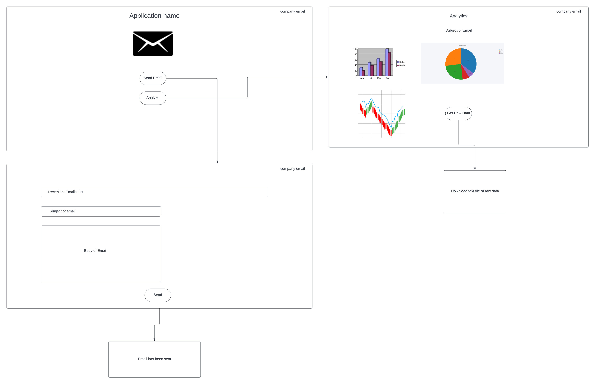
Wireframe

Slide 7
Algorithm
We check whether user exist in database or not If user found: We will create object of user with matching email Else: We will add user with particular email and create object of it.
Then we create unique code and add unique code to user instance. Then we create image url using inbuilt library
Then attach unique code with url.
Then we pass all the data of email along with image URL to email template.
Send email request will be given.
Then we have to create an api which return image when we use get request for the URL.
We can also perform multiple operation along with returning image with this get api

Slide 8
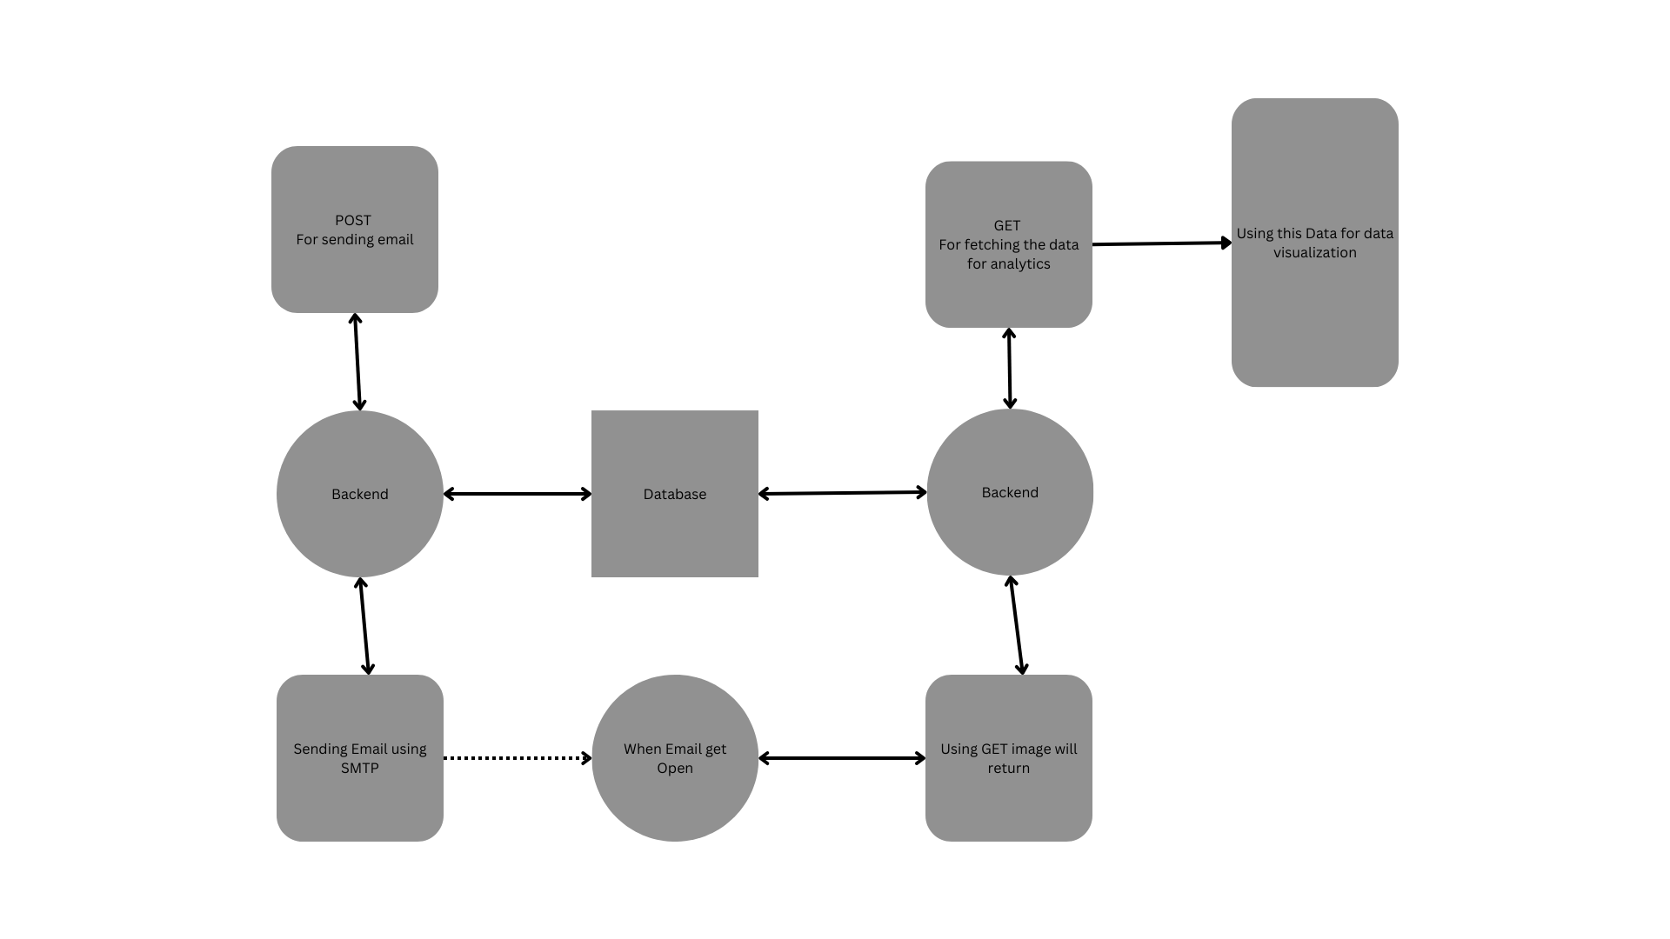
Data Flow Diagram

Slide 9
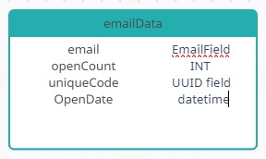
Schema

Slide 10
Thank You

